Slide 1
Build a simple application with Data Access using Spring Boot & Spring Data JPA

Slide 2
Objectives
Build application with Data access
Create a new Maven project in IntelliJ IDE
Add the necessary dependencies for Spring MVC and data access
Create the Model - Define the entity classes that represent domain objects
Define the data access object (DAO) interfaces and their implementations for interacting with the database.
Create the Controller
Set Up the Views
Create the views using JSP, Thymeleaf, or another templating engine
Implement the Business Logic
Testing
Run the Application

Slide 3
Demo Spring Boot with Thymeleaf Engine with Repository Pattern

Slide 4
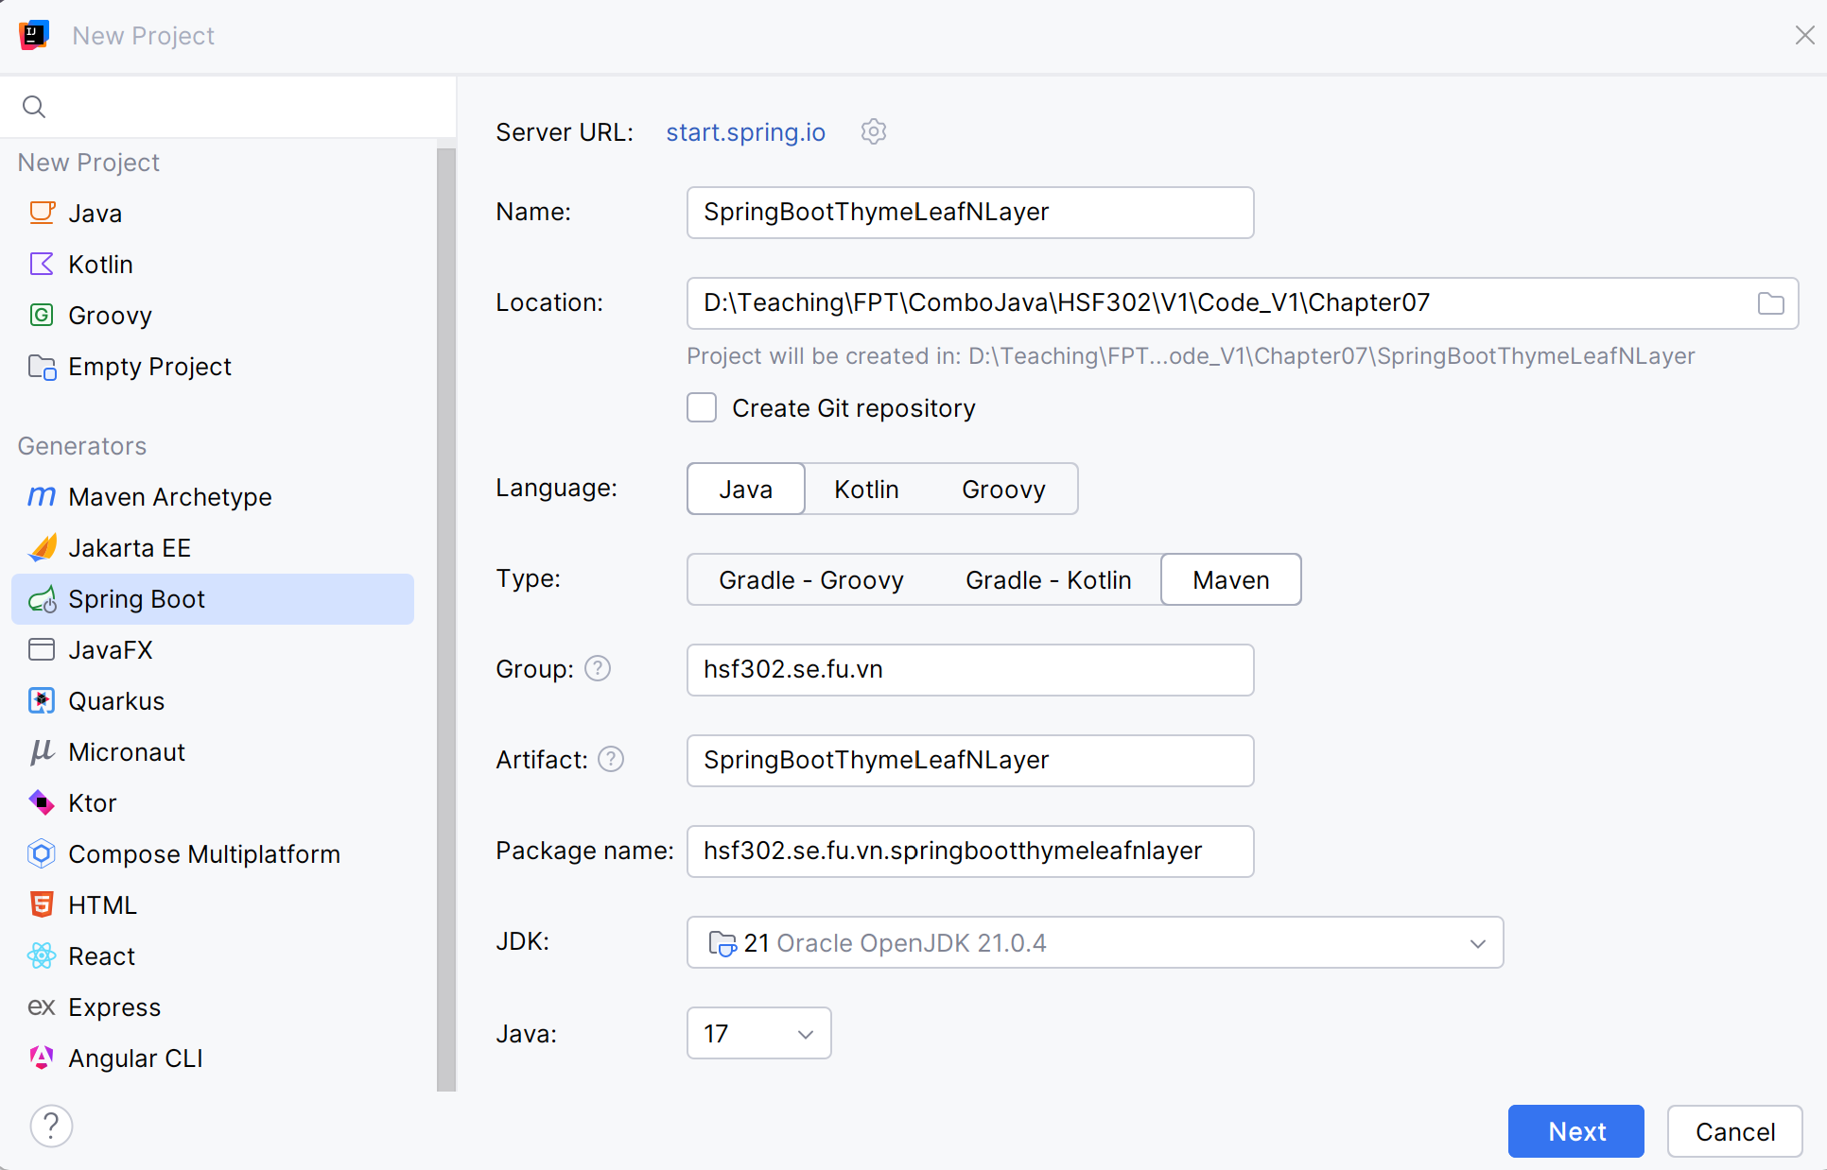
Create a simple project using Thymeleaf

Slide 5
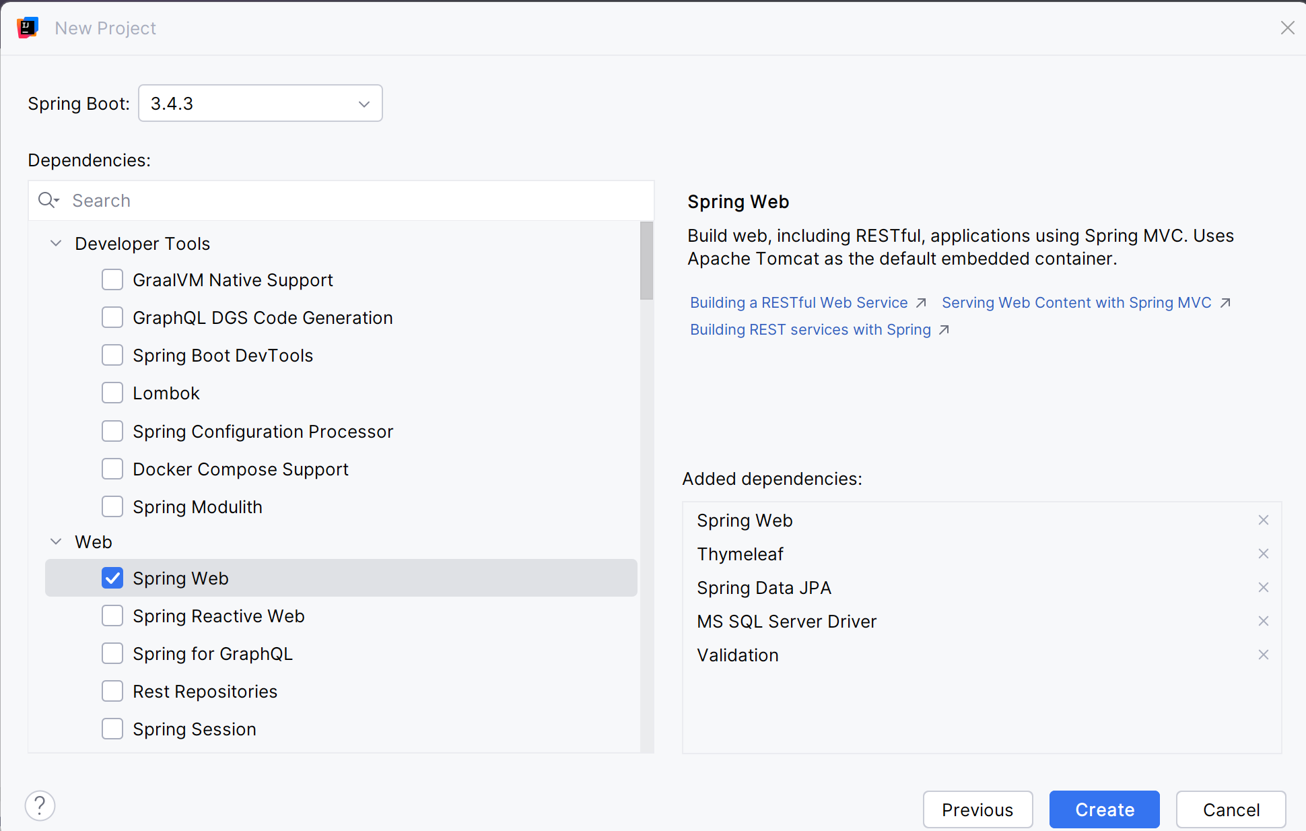
Add dependencies

Slide 6
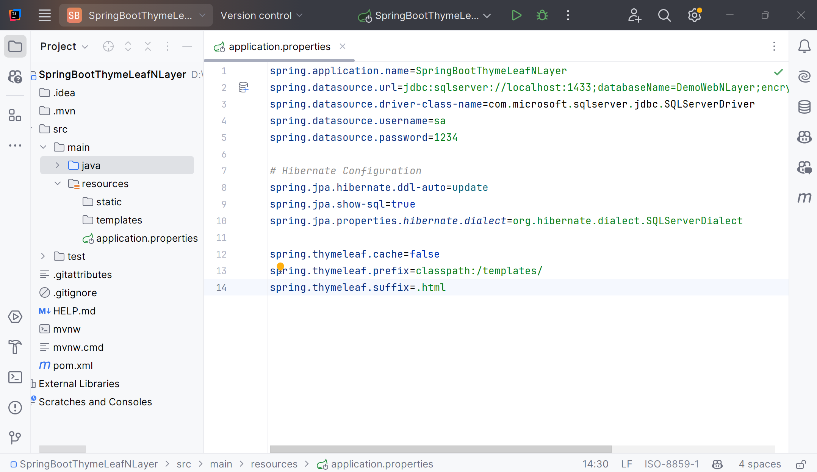
Update the application.properties

Slide 7
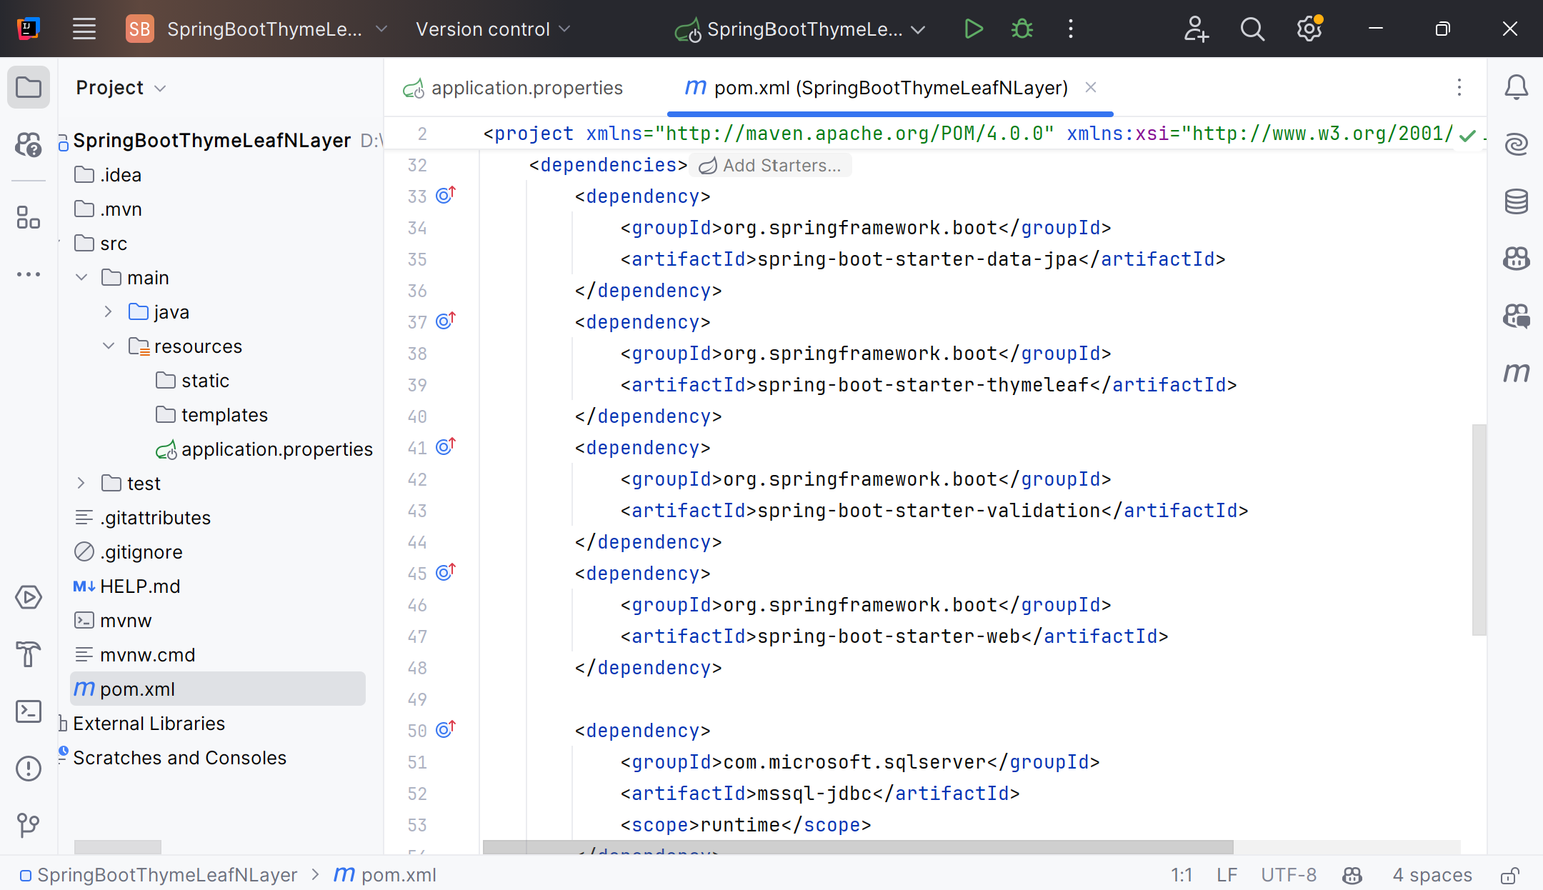
Check the pom.xml

Slide 8
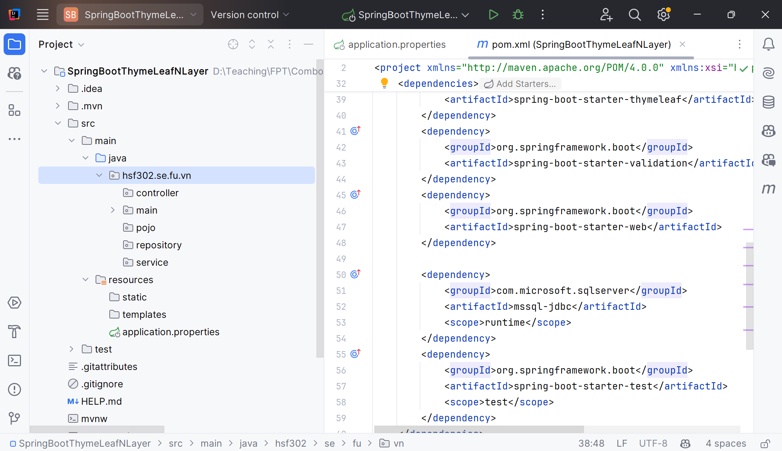
Create the Structure Project

Slide 9
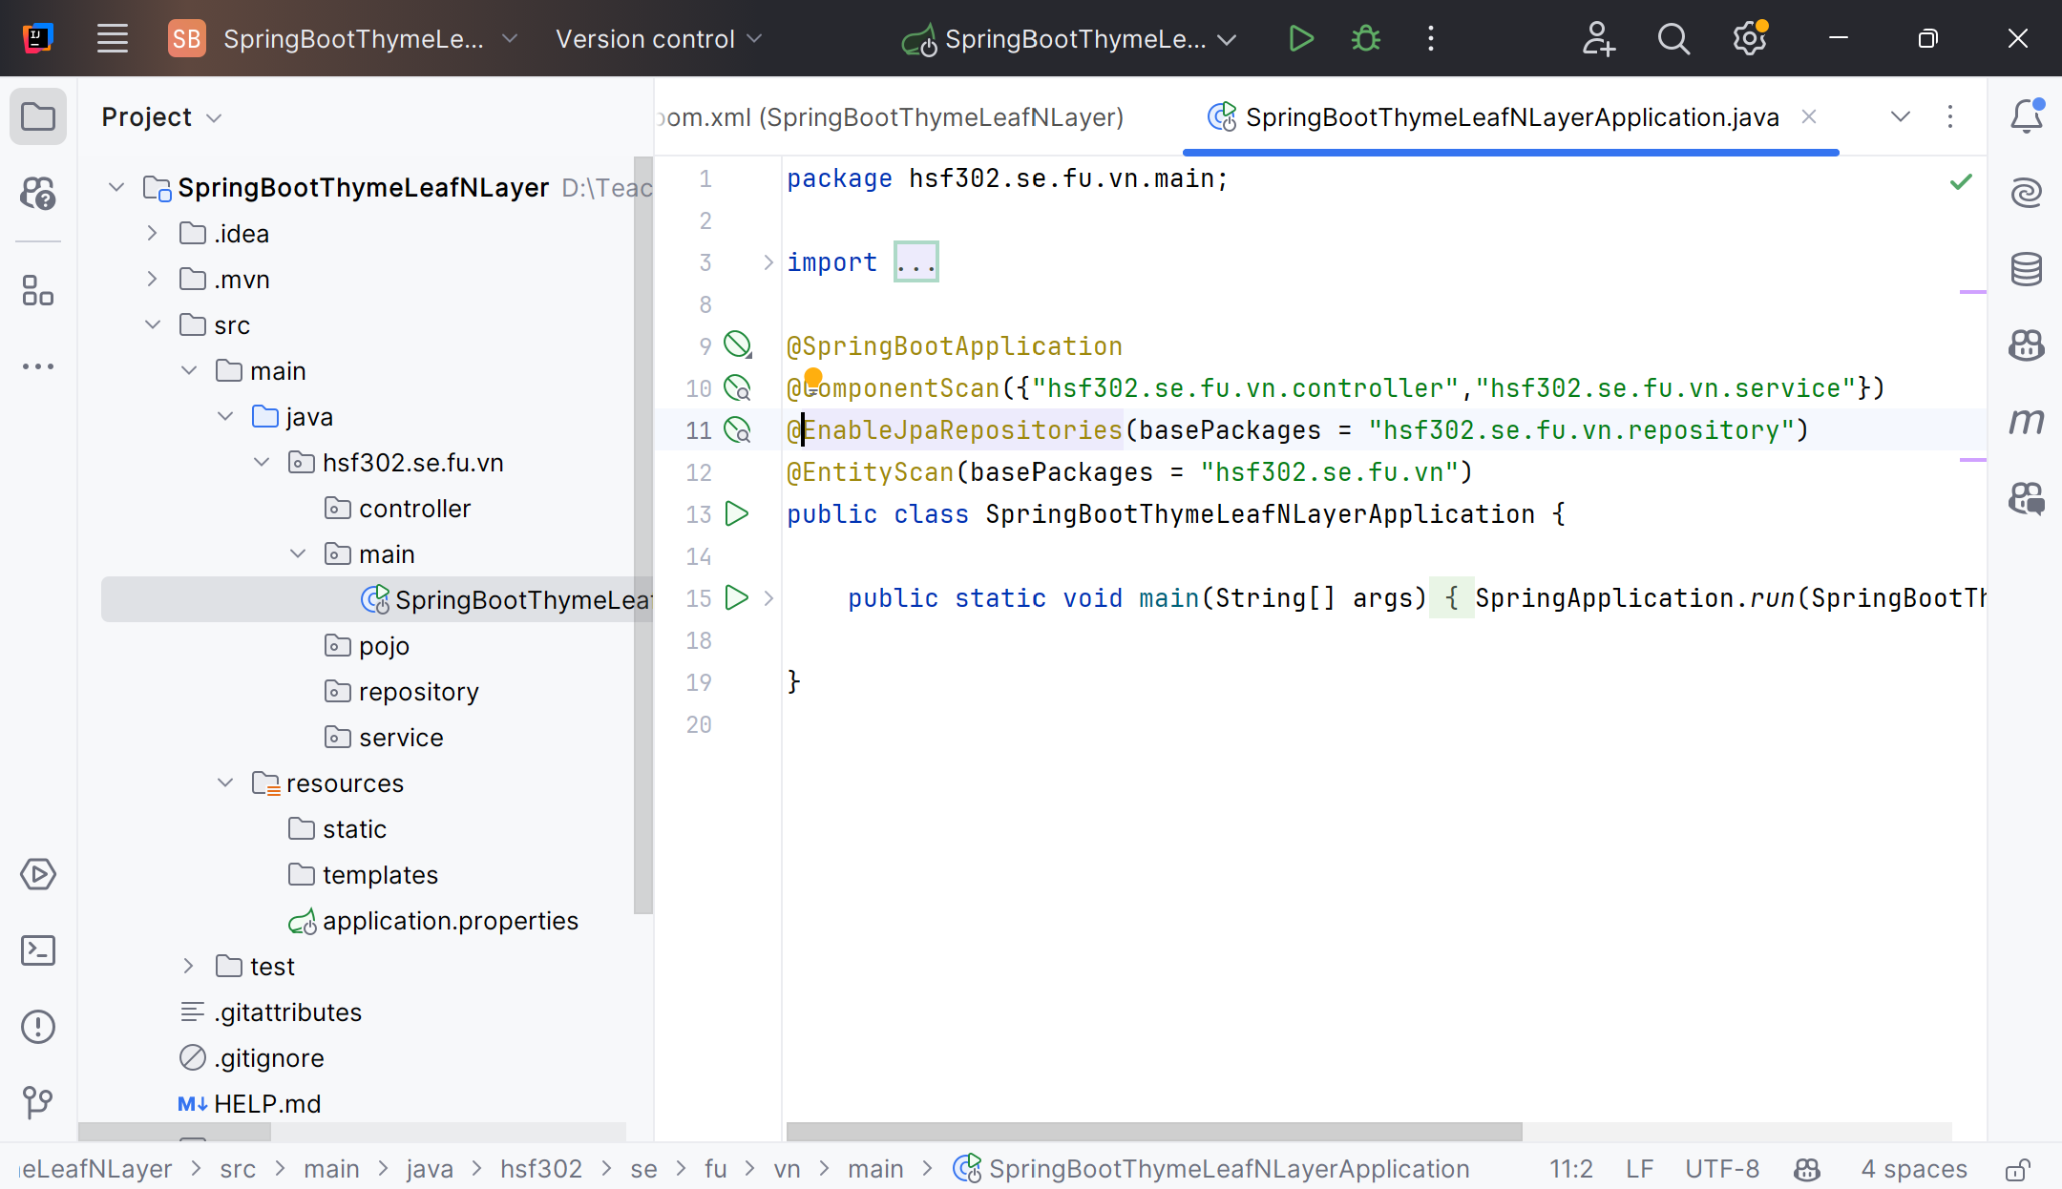
Update main function

Slide 10
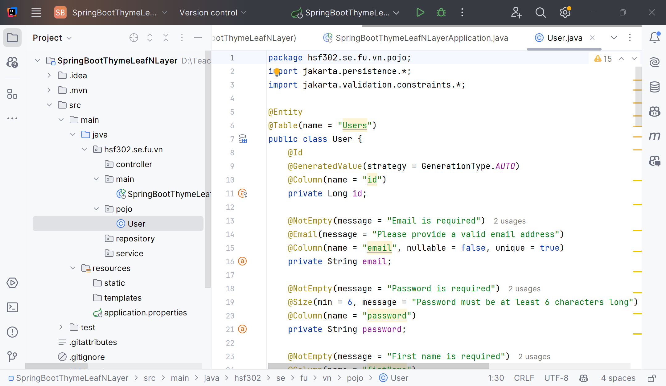
Pojo and validation

Slide 11
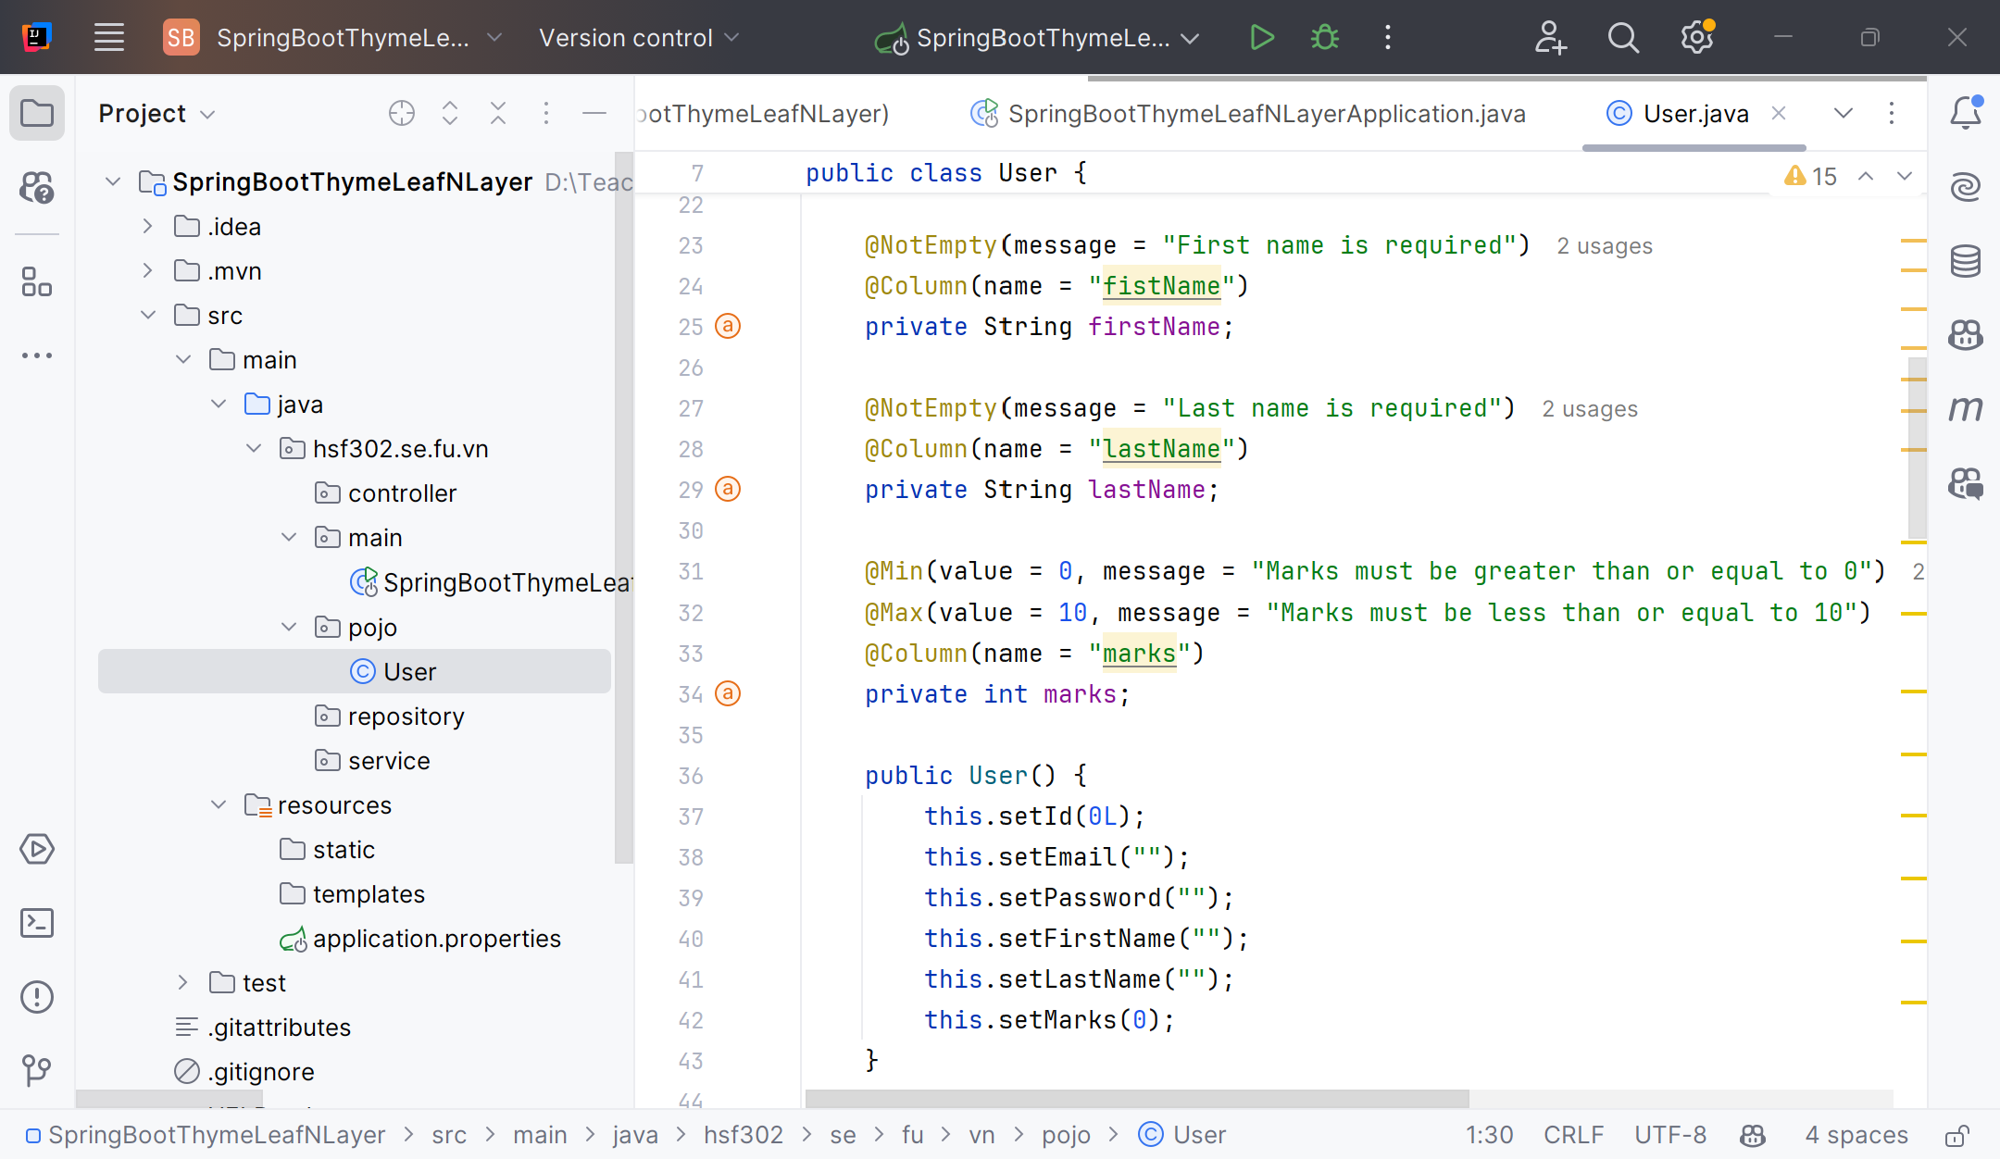
Pojo and validation

Slide 12
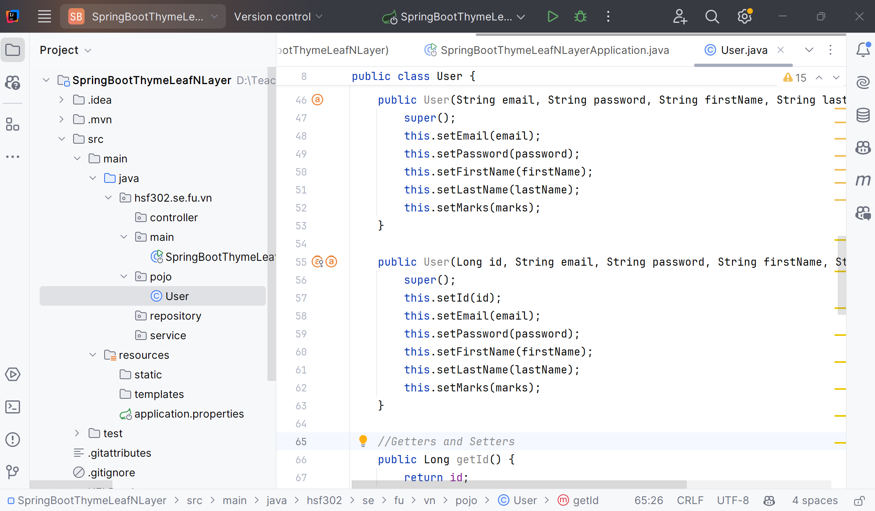
Pojo and validation

Slide 13
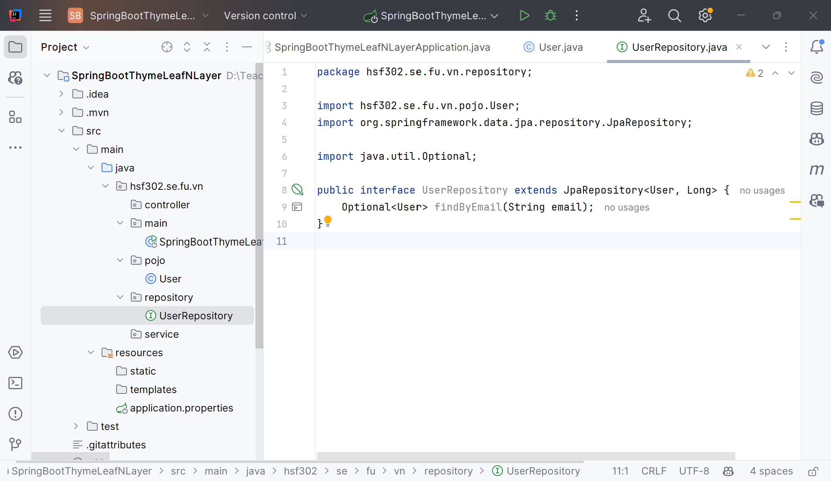
Create the UserRepository.java

Slide 14
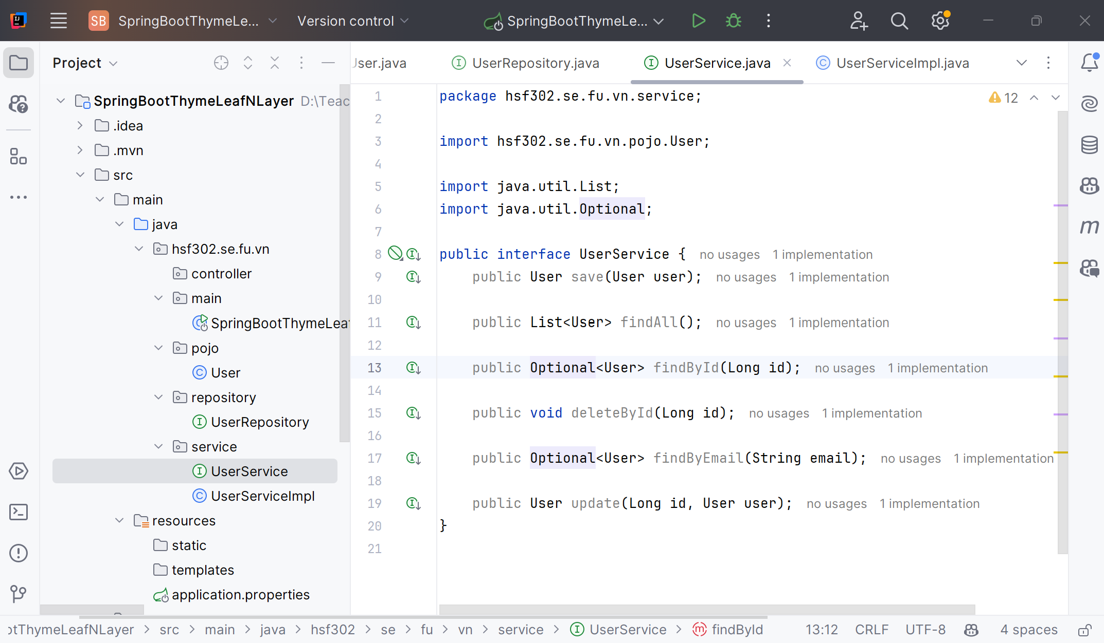
Create the UserService.java

Slide 15
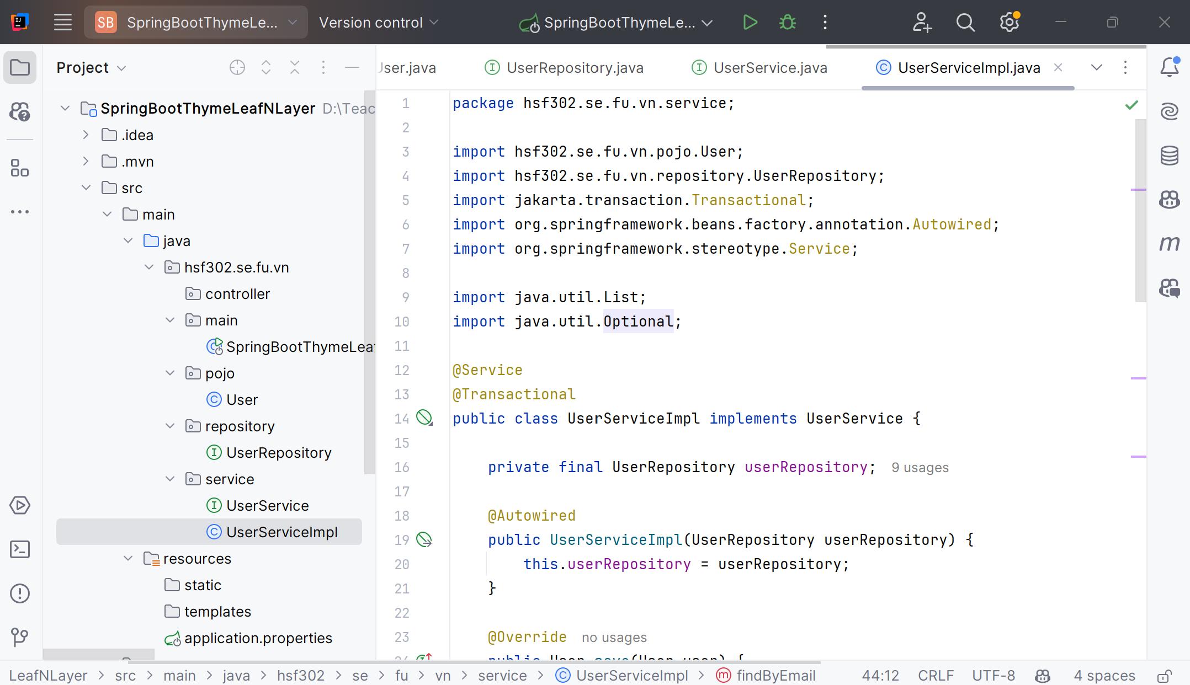
Create the UserServiceImpl.java

Slide 16
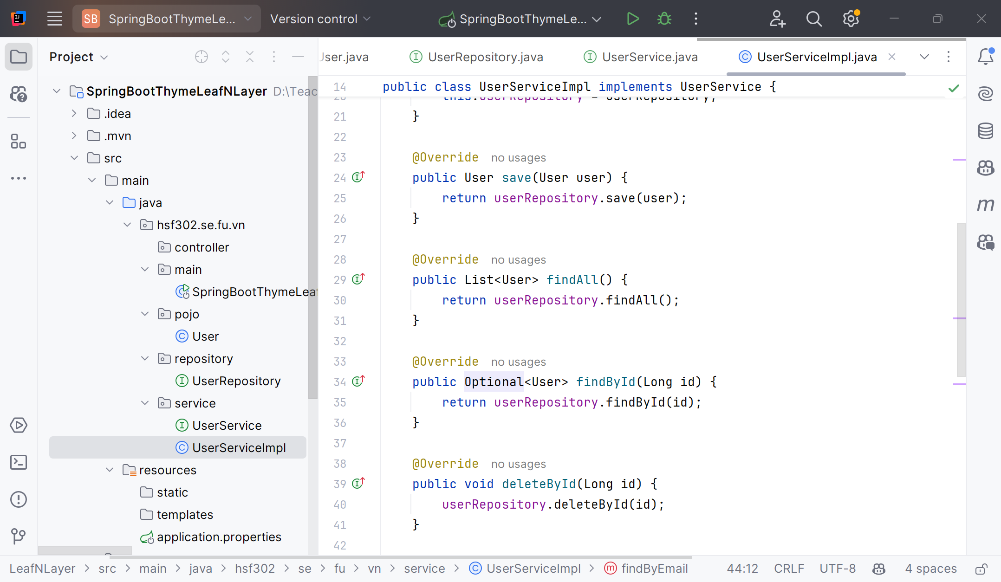
Create the UserServiceImpl.java

Slide 17
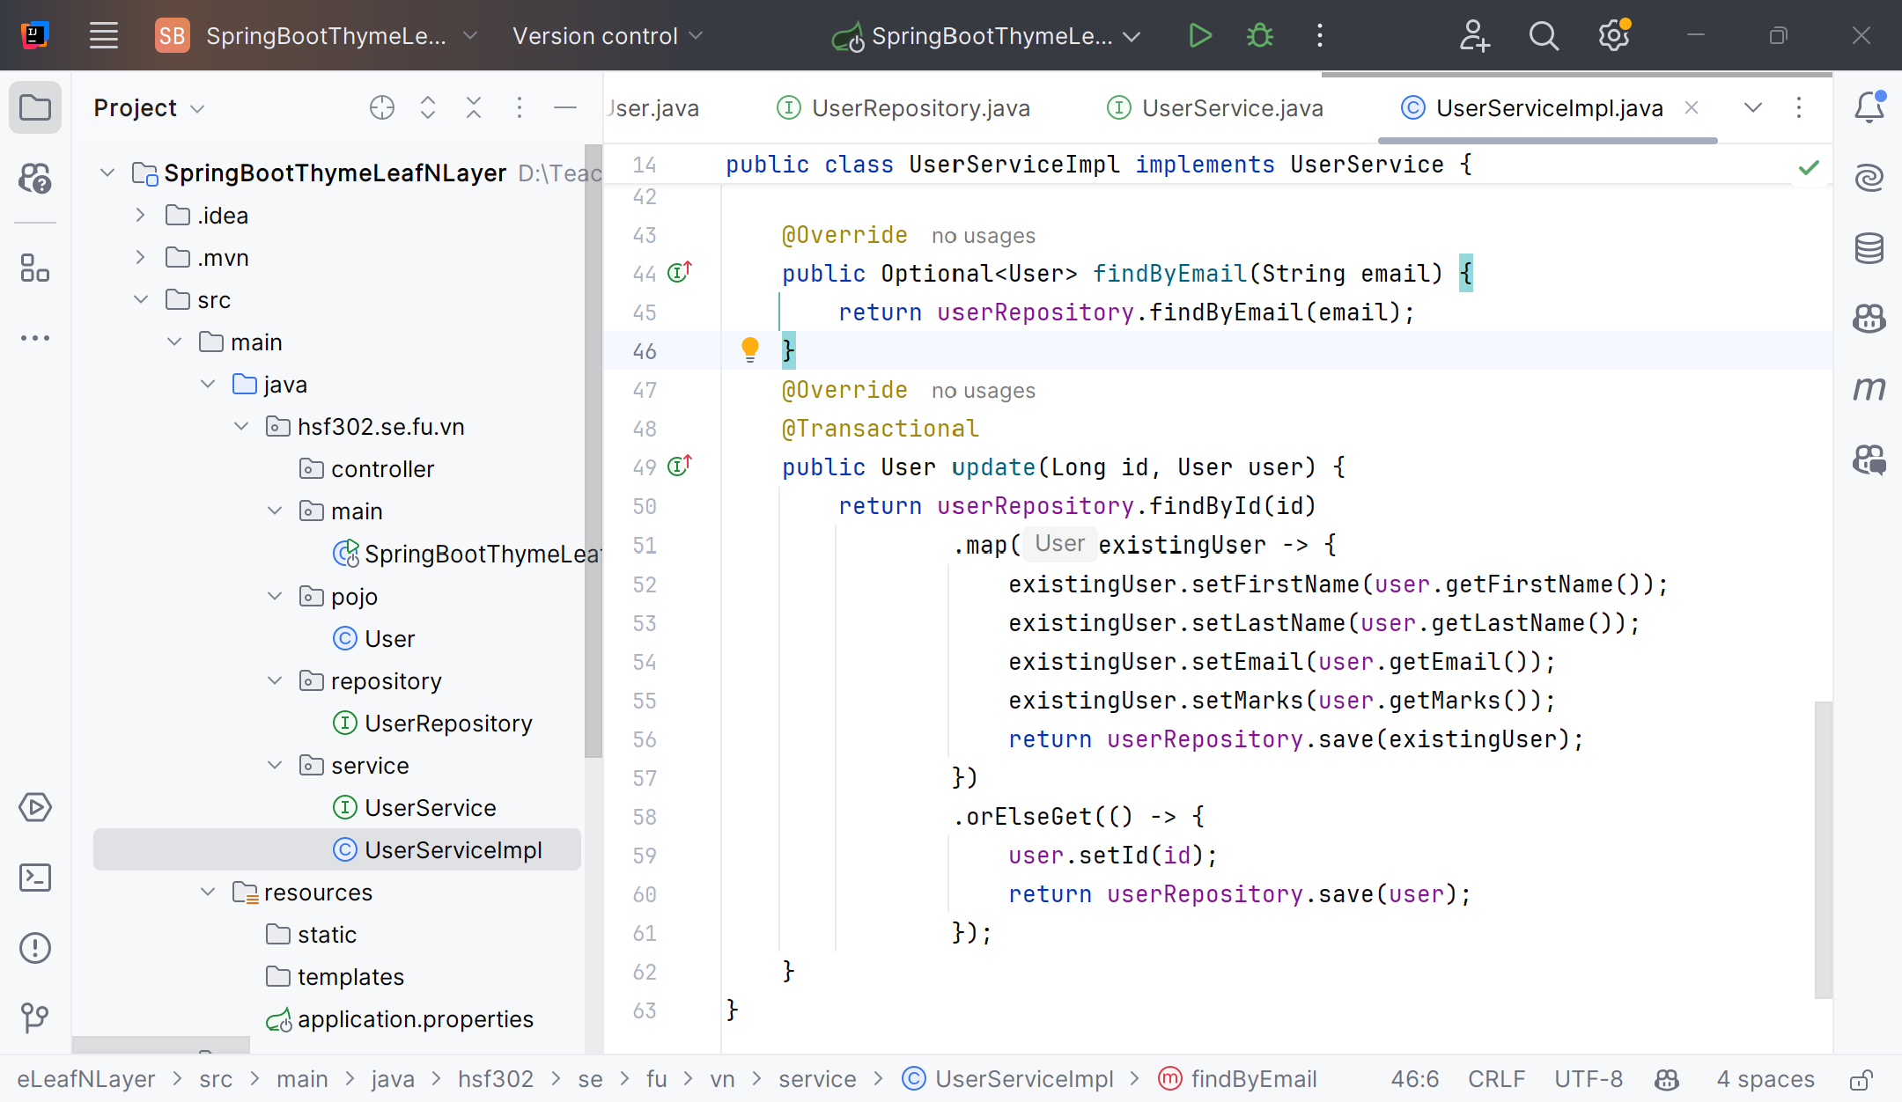
Create the UserServiceImpl.java

Slide 18
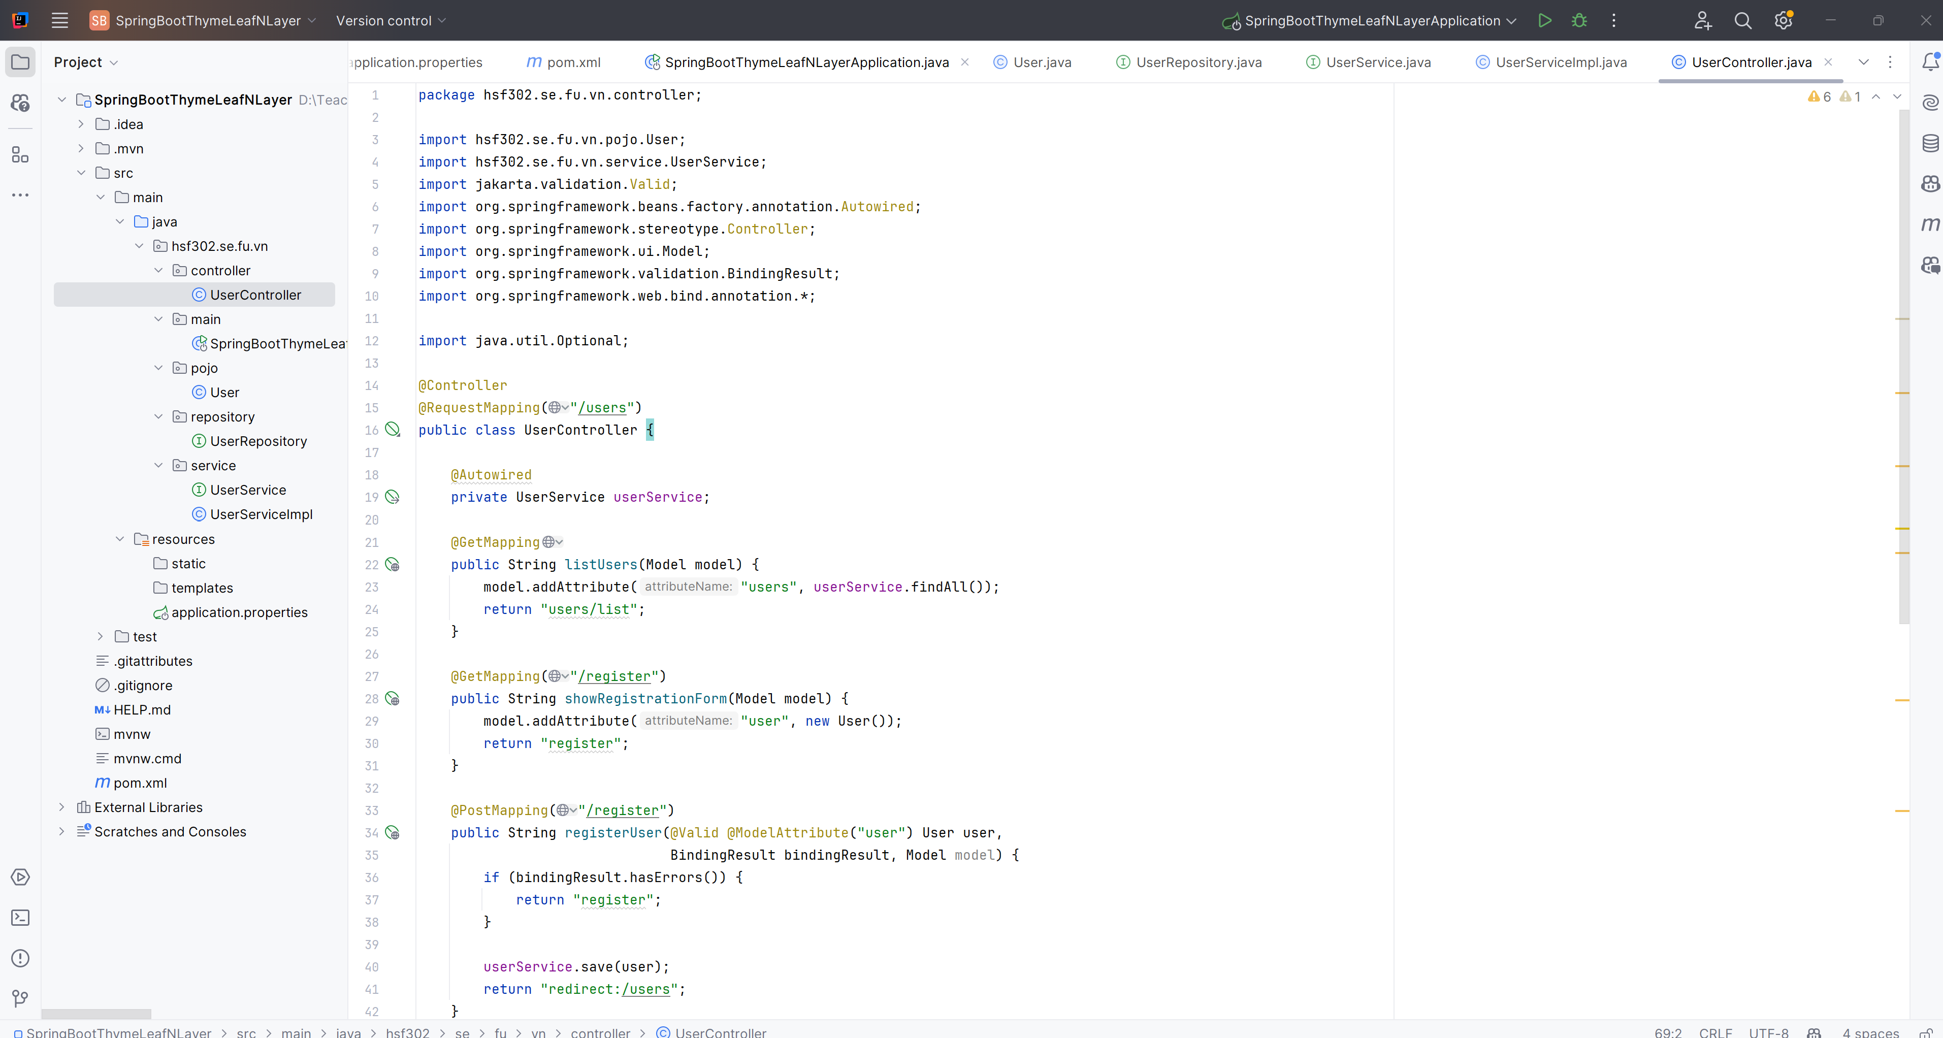
UserController

Slide 19
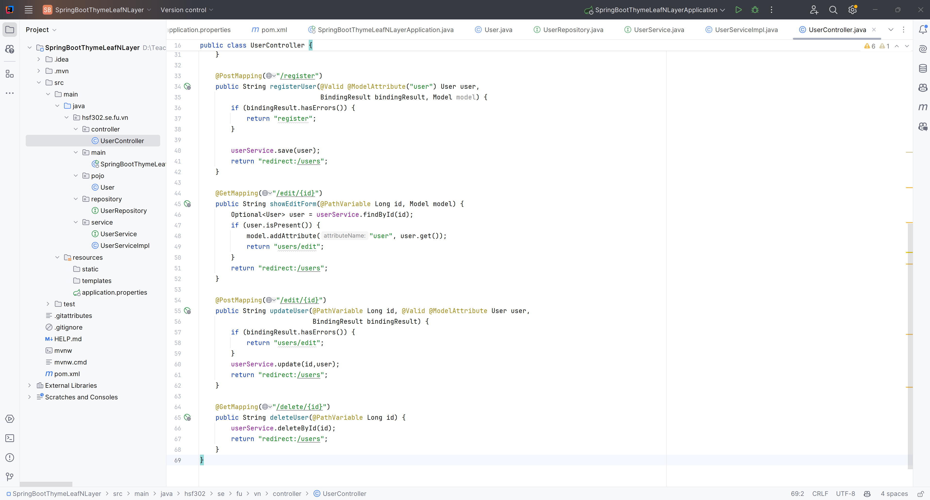
UserController

Slide 20
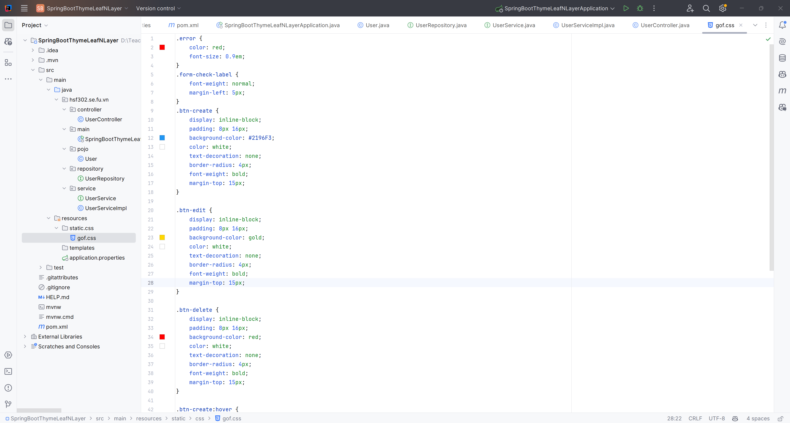
Create the css

Slide 21
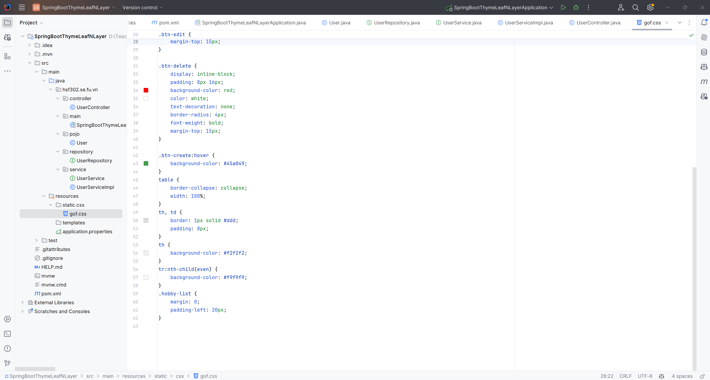
Create the css

Slide 22
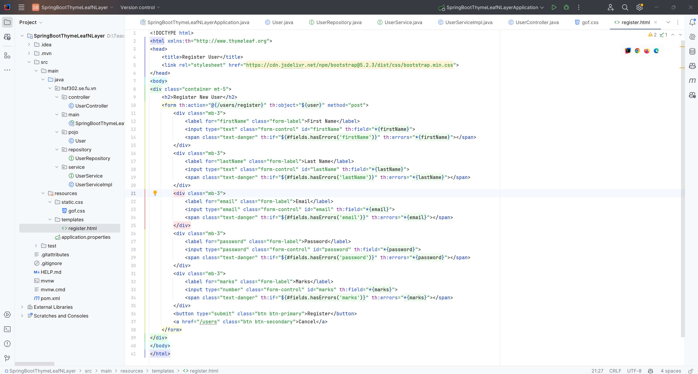
Create register.html

Slide 23
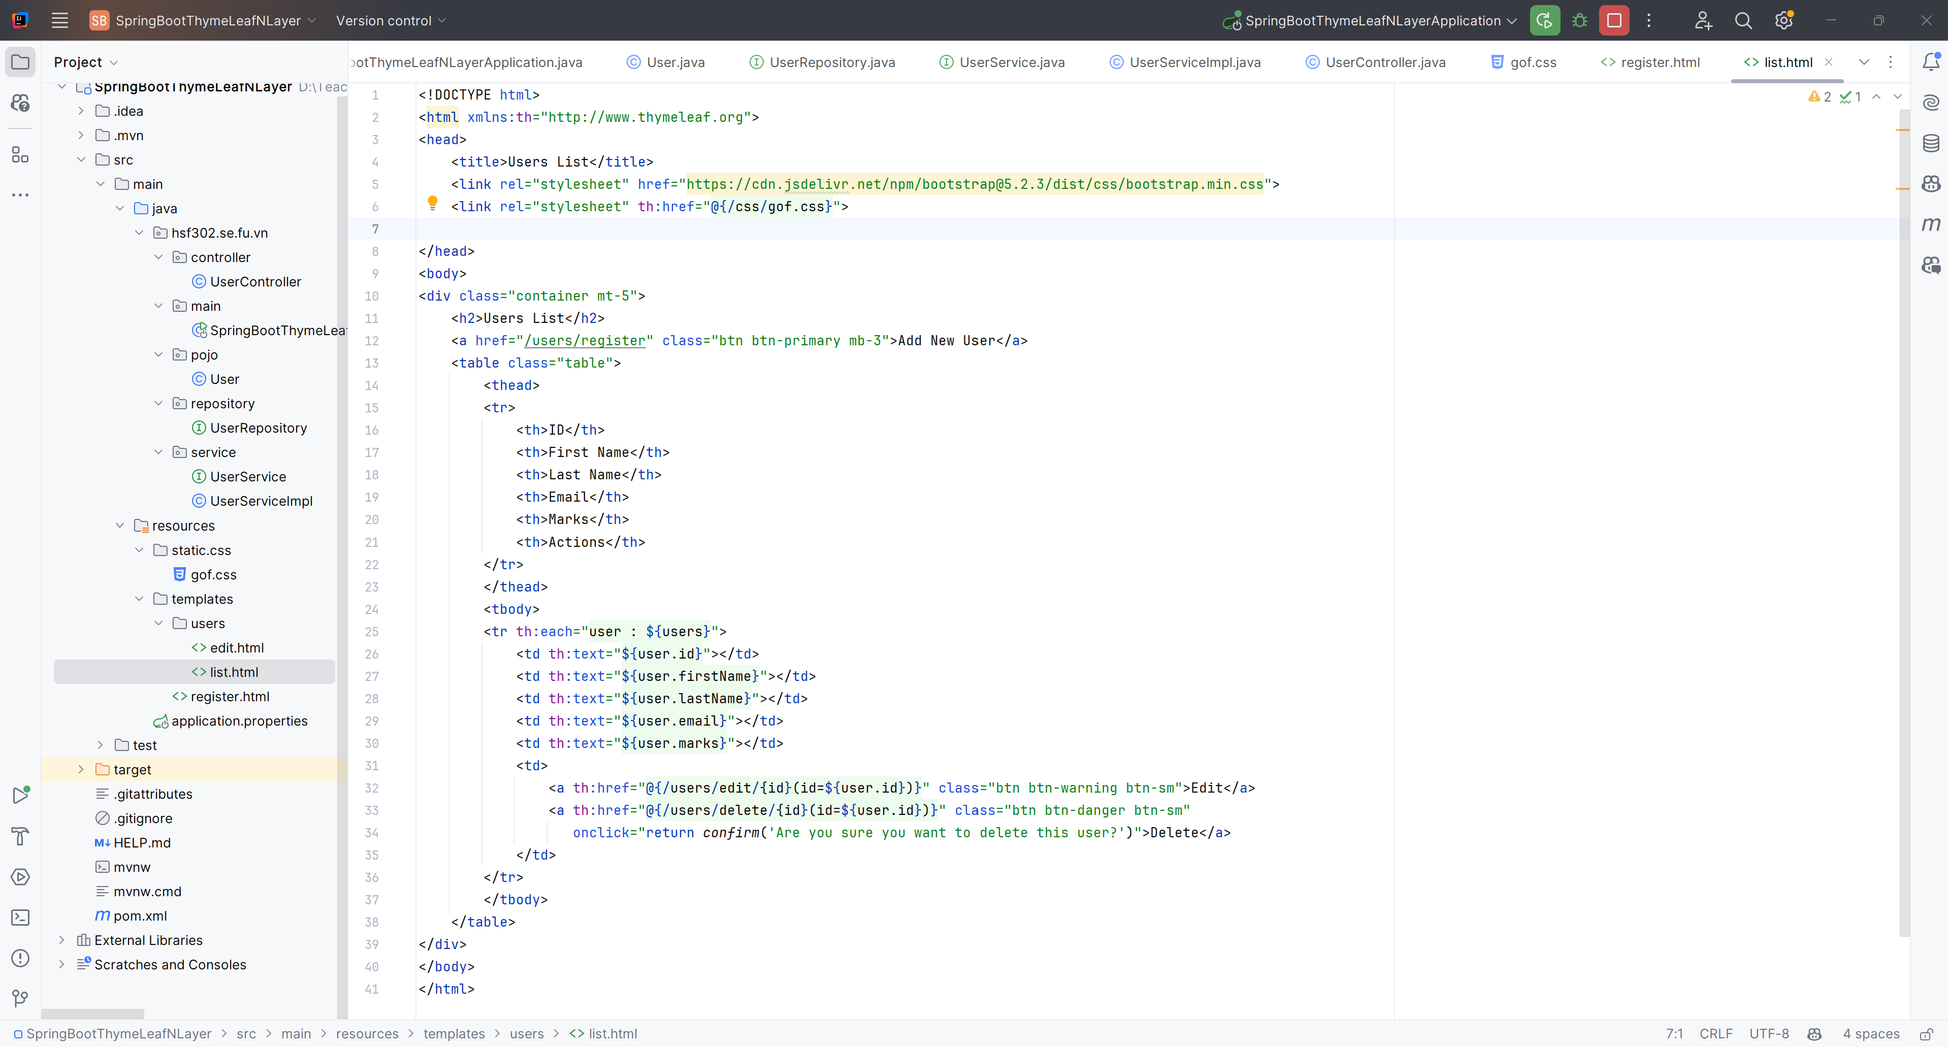
Create list.html

Slide 24
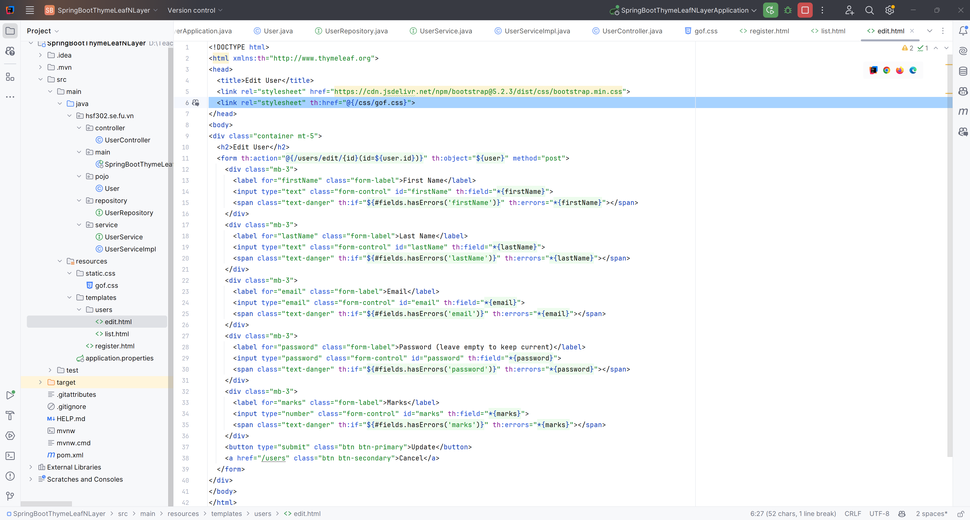
Create edit.html

Slide 25
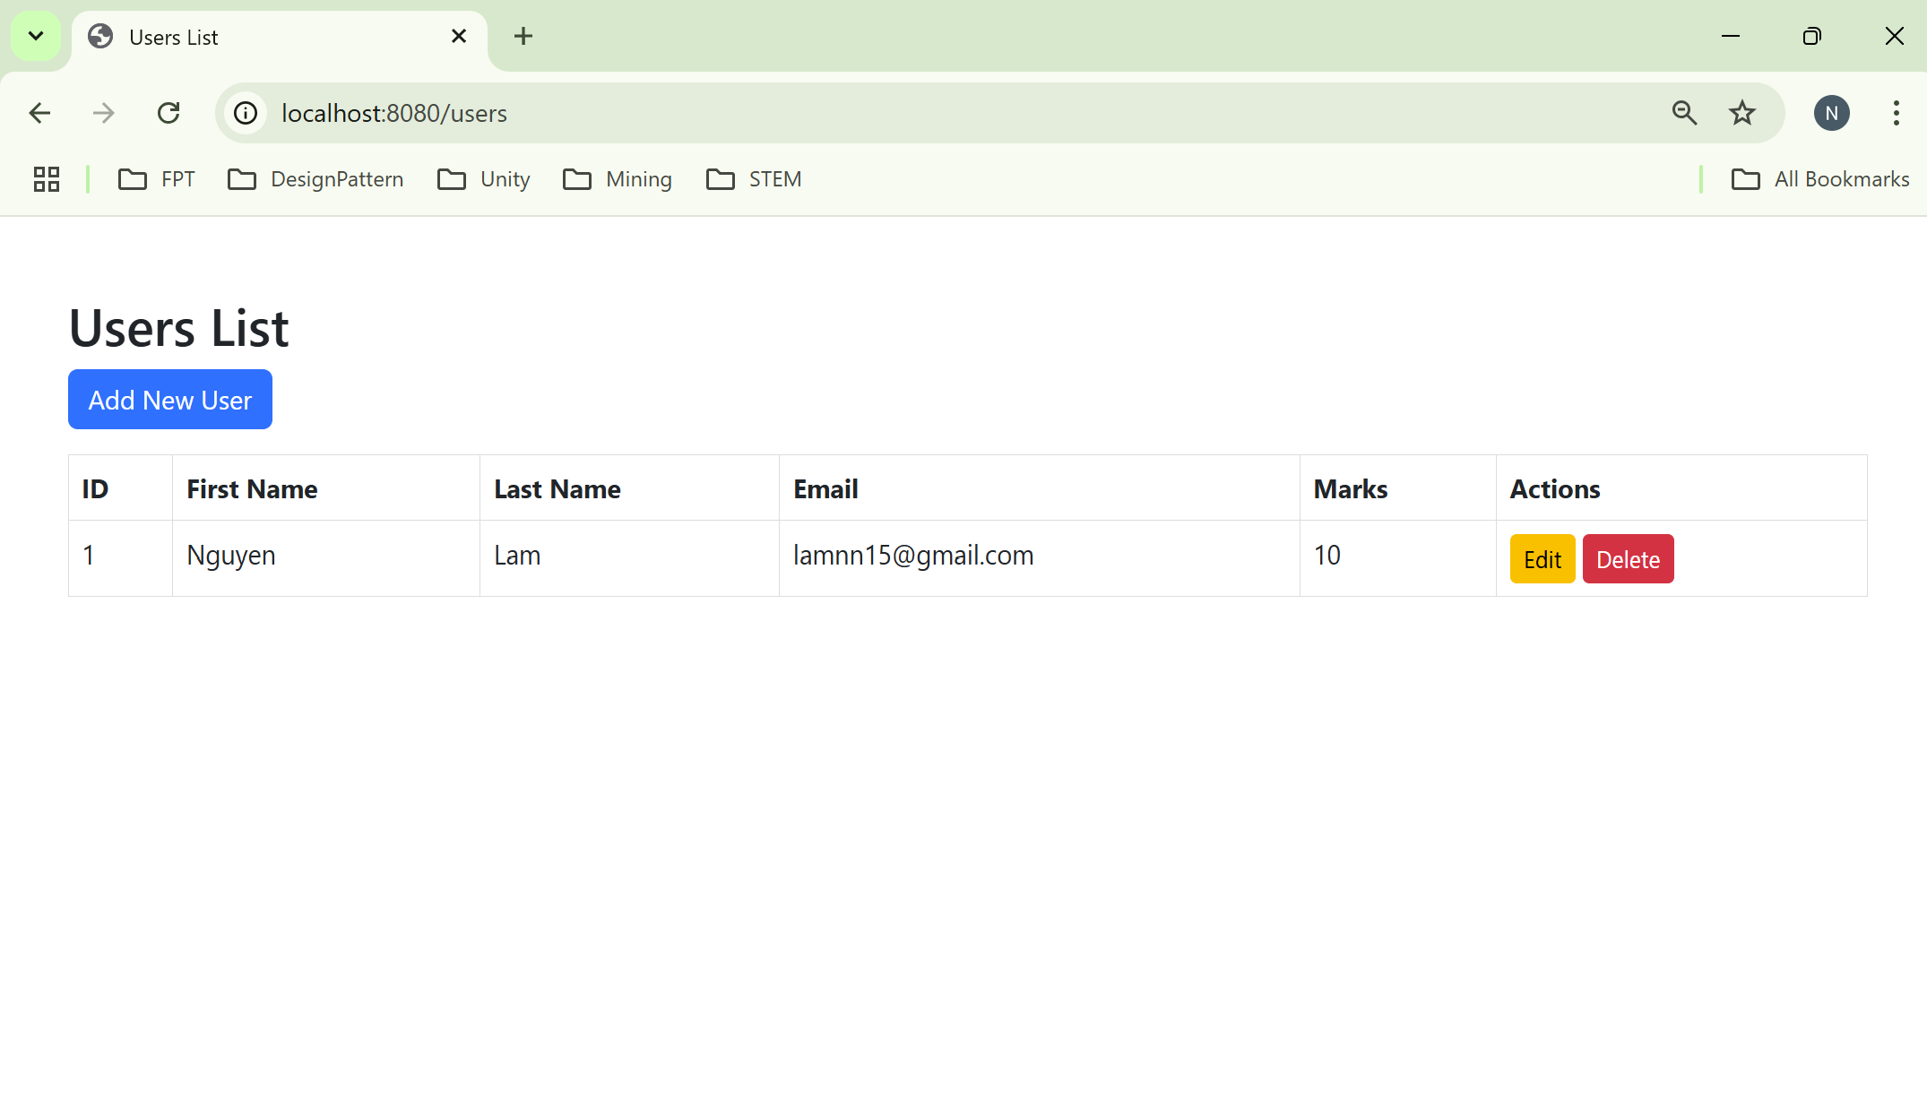
Result

Slide 26
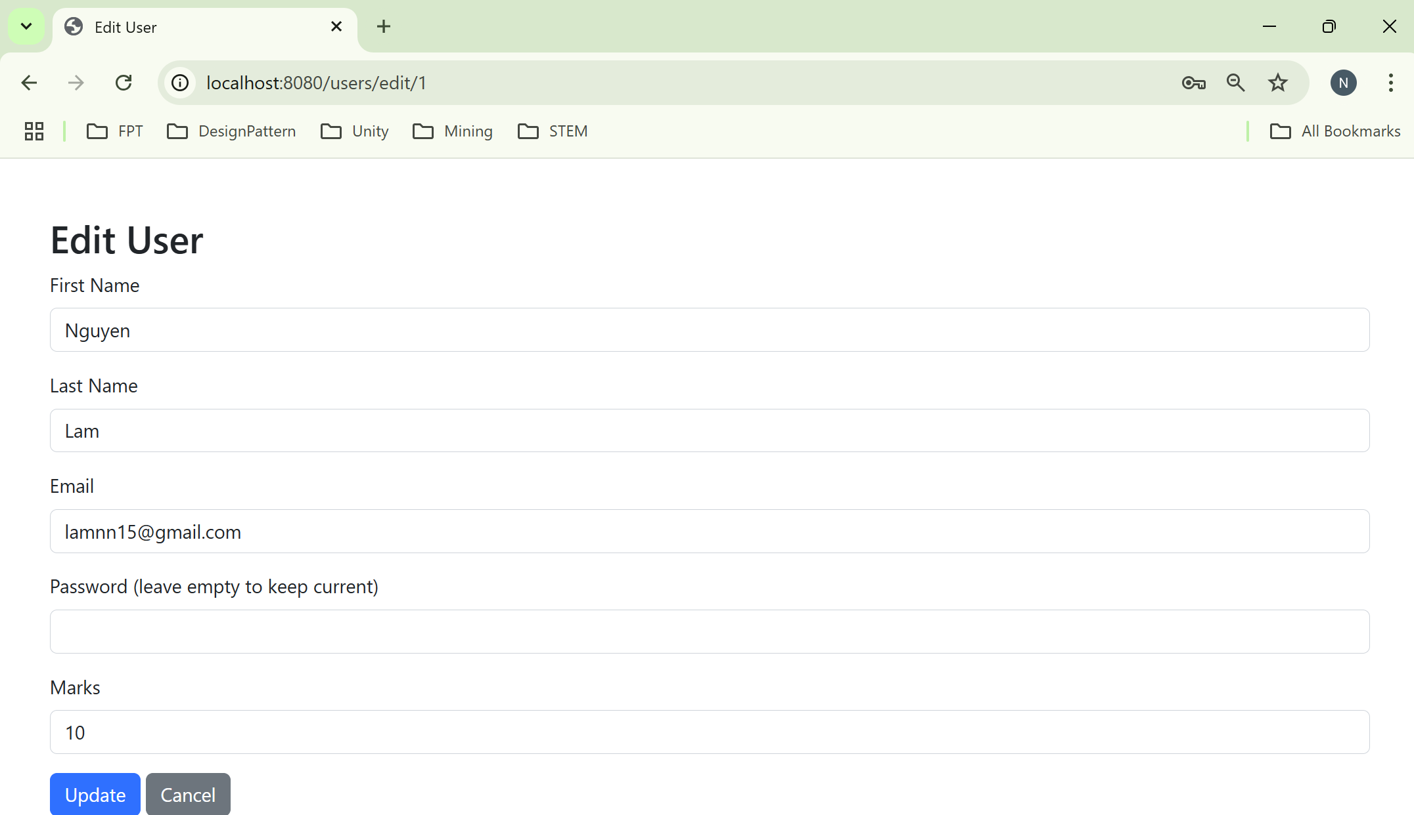
Result

Slide 27
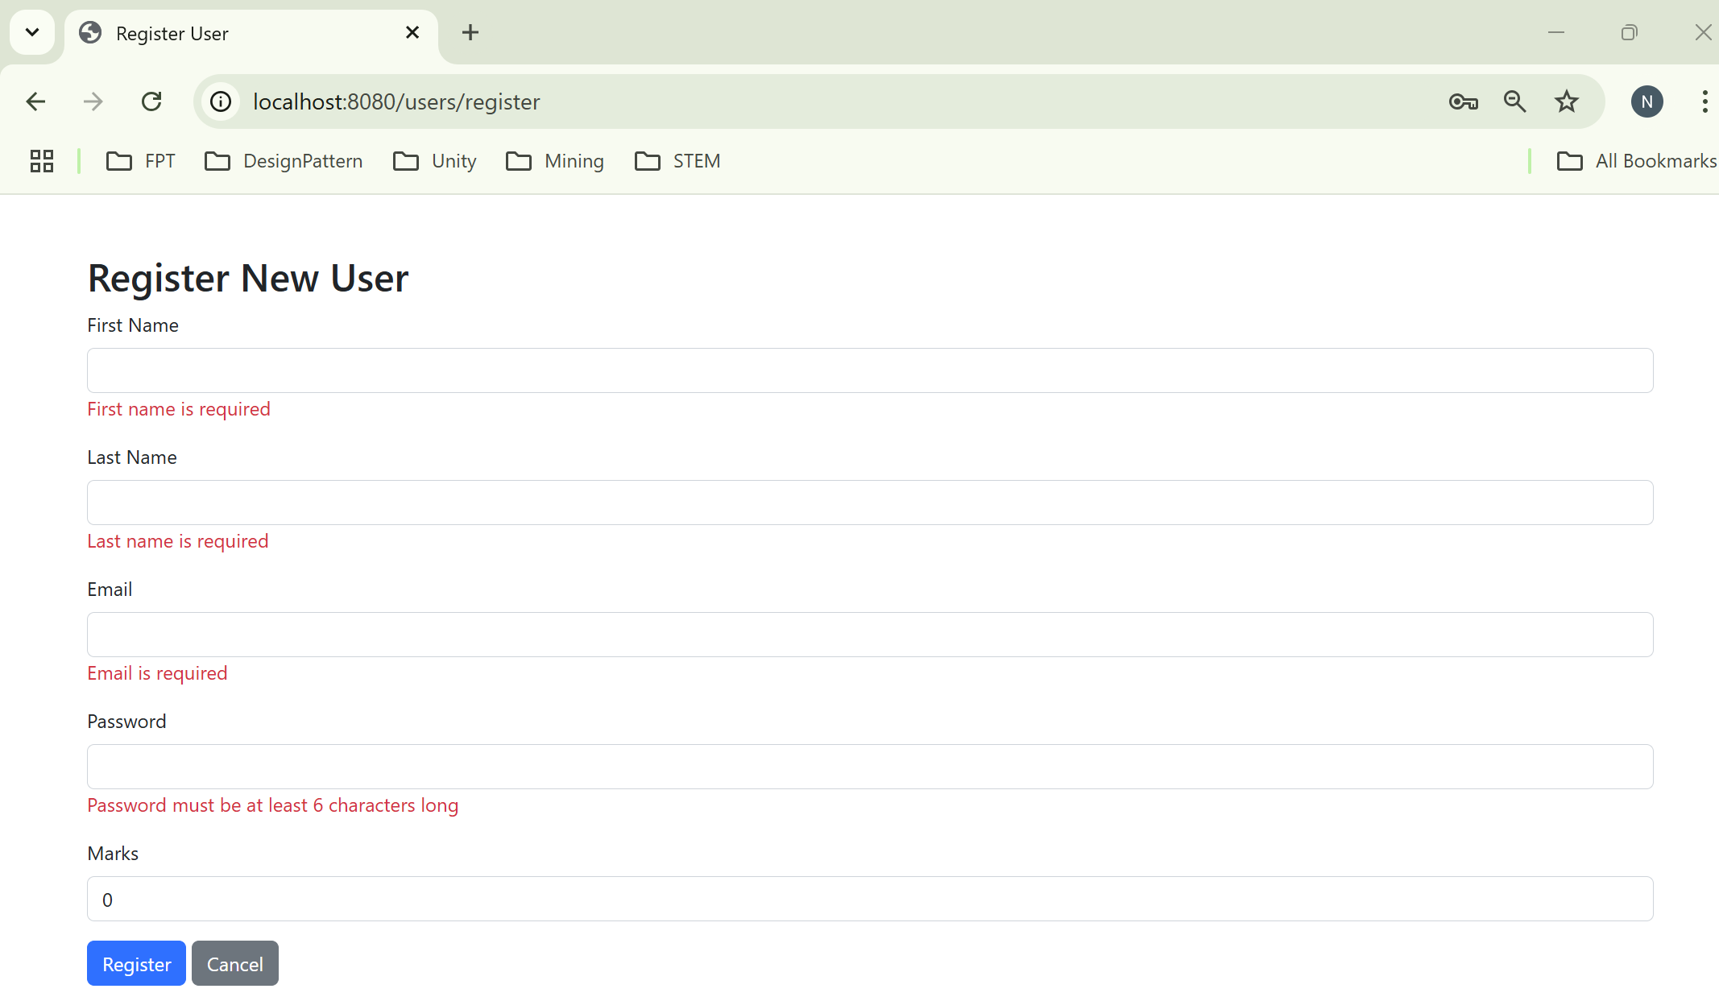
Result

Slide 28
Summary
The concepts are introduced:
Create a new Maven project in Eclipse IDE
Add the necessary dependencies for Spring MVC and data access
Create the Model - Define the entity classes that represent domain objects
Define the data access object (DAO) interfaces and their implementations for interacting with the database.
Create the Controller
Set Up the Views
Create the views using JSP, Thymeleaf, or another templating engine
Implement the Business Logic
Testing
Run the Application

